Slide 1
https://powercybertestbed.ece.iastate.edu/
PUSH ALL WORK TO GITLAB AND IN VM!!!!!1!!!

Slide 2
Week 2/19

Slide 3
Who are Present Today
Justin, Kaya, Matt, Tommy

Slide 4
Justin - Work
This week
Finally got the HELICS example to work in the Dockers
Further optimized the Dockerfiles to rerun code less frequently
Starting working on HTTP commands to control the Docker environment
Flask is kinda awful
Future Work
Help everyone get up to date on using the newest Dockerfiles
Keep working on the HTTP requests
Use Zach’s frontend showed last semester to make the frontend look not so awful

Slide 5
Kaya - Work
Realized pireceiver is not being initialized by json config file, so attempted to add that:
Used chatgpt, surprisingly helpful. It suggested to add: print(f"Before first time request - Federate State: {h.helicsFederateGetState(vfed)}") to the logger, which returns a code about the state of the federate, which corresponds to"Startup", "Initialize", "Executing", "Finalize", and "Error". 4 means error.
Problem was having both flags declared as “wait for time” set to true in the config file.
Currently the first value receiver receives is a wacky -9999999999 but I think it’s running before sender and hence gets that value. All other values are fine

Slide 6
Kaya - Work
More work on the bidirectional pi sender/receiver. Starting off with just using receiver to send the value 12345 back to sender.
Encountered error: duplicate federate.
Fixed this by changing the pub = h.helicsFederateRegisterGlobalTypePublication to pub = h.helicsFederateRegisterTypePublication
It technically runs, however it is not getting all of the correct values.
Also added FederateDestroy() to the end of sender. Noticed that was absent. “Duplicate federate name” or “socket bind was busy” error often tends to be when there are still helics instances running somewhere.
Attempted to get the gridlab-d example to work, but complicated to install so gave up. May still use as a reference.

Slide 7
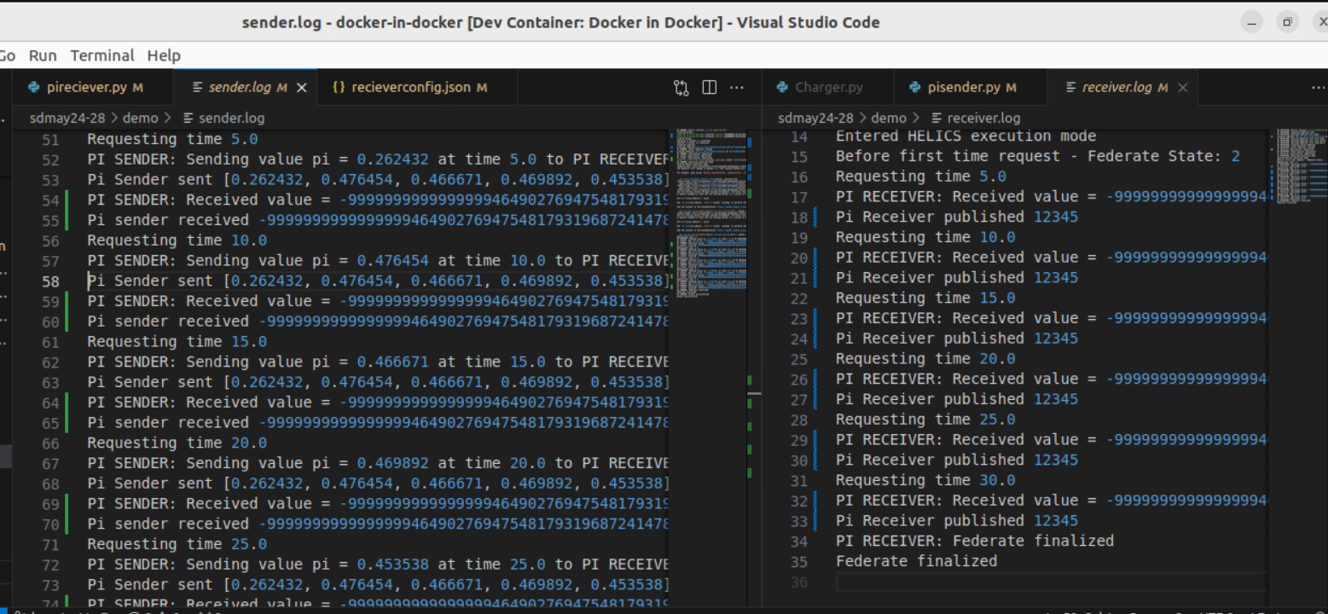
Kaya - Work

Slide 8
Kaya - Next Steps
Fix the bidirectional numerical errors.
Work on adding a third federate.
Should this be a controller? Or an additional value federate?
Start integrating panda power maybe?

Slide 9
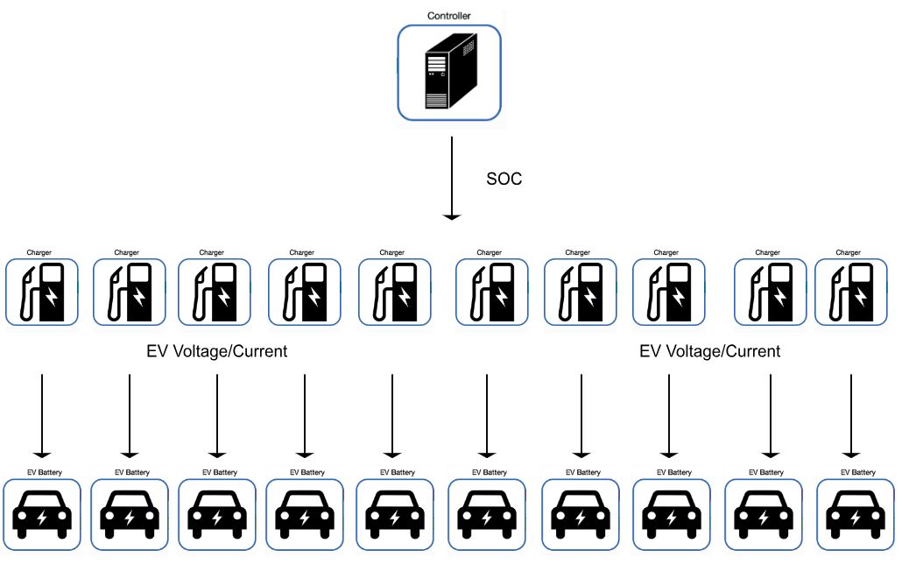
Matt - Work
Use case 1

Slide 10
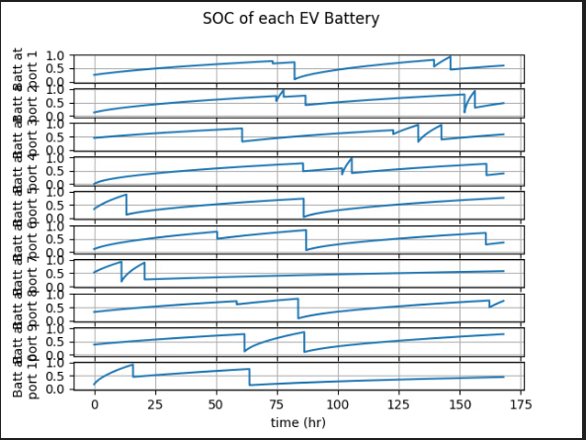
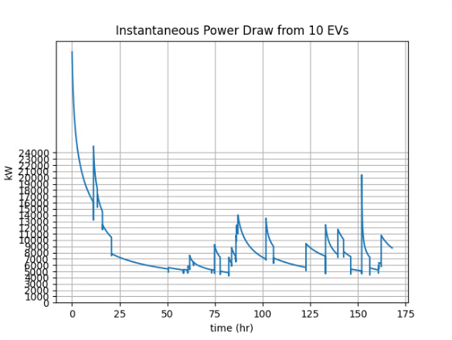
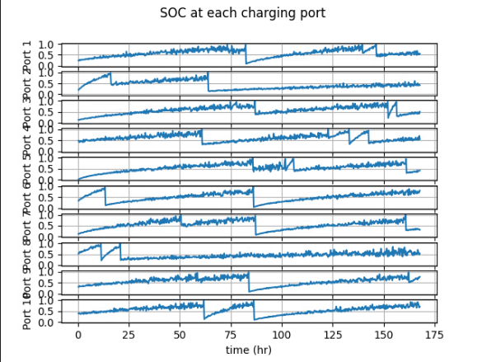
Matt - Work

Slide 11
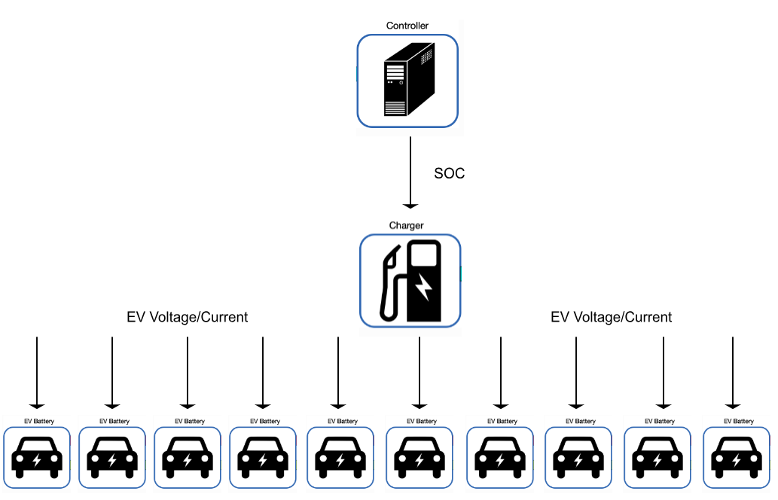
Matt - Work
Use case 2

Slide 12
Matt - Work
Helics has a multi-input example that uses a single charger and multiple EV batteries
I explored this example, but seems useless for our application
Is there an instance where we would want to model multiple EV loads on a single charger?
I think that most charging instances have a single charger for a single EV, I have never heard of several EVs connected to a single charger

Slide 13
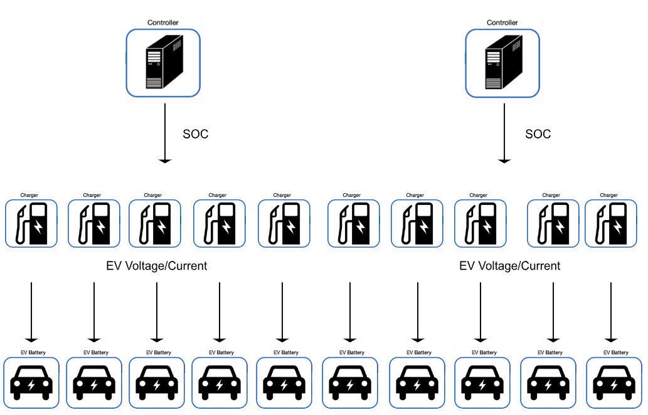
Matt - Work
Use case 3

Slide 14
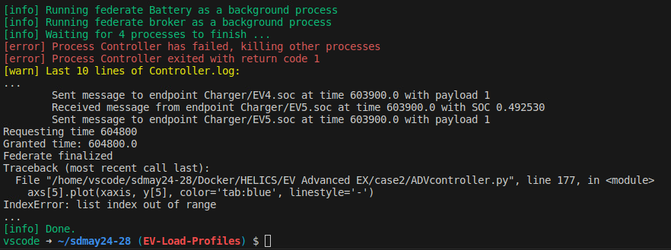
Matt - Work

Slide 15
Tommy Work
DSS-Python code not working at all
Uses code directly from documenantation and cannot import dss correctly into my program
Treats the import dss as a variable instead of a function

Slide 16
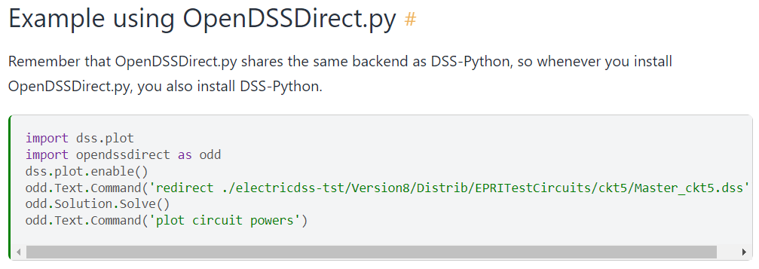
Tommy Work
Output
Tried using OpenDSSDirect.py and it too did not work

Slide 17
Tommy Work
My Code
Output

Slide 18
Tyler - Work
Met with the team last wednesday to discuss current status of everything
Helped Tommy a little bit with DSS_Python (weird coloring in vscode caused some problems)
Looked into Pandapower a little more to work on a plan of execution for the state estimation false data injection. Nothing concrete yet as I am trying to understand their methods and documentation.
Looked into possible EV/Distribution attacks.
Since the Substations are in DSS_Python, figuring out a way to open the breakers is most likely gonna be one of the attacks. Haven’t found anything else concrete after talking with Matt and Thommy.
Talked with Matt and Tommy on how we could have a constantly running simulation (so go from baseline to attack scenario back to baseline without redoing the docker setup/simulation).
For this next week: Try to get one of the electric grid HELICS examples to run to start playing around with possible attack paths, more attack research/team help

Slide 19
Zach - Work
Dealt with a massive merge conflict when trying to pull Tommy’s branch
Started working on examples from Paulo Radatz’s Youtube channel
Future: Work more with Tommy on getting DSS-Python working

Slide 20
Meeting Minutes
Justin (15 mins)
Kaya (7 mins)
Matt (17 mins)
Tommy (5 mins)
Tyler
Zach

